Slide 1
أكـــــاديميــــة طــــويـــق
Artificial Intelligence Ethics

Slide 2
Case Studies on Bias and Fairness & Practical Approaches to Fair AI Development
By: Dr. Afshan Hashmi

Slide 3
Course Objectives:
Recognize the ethical implications of AI in decision-making and its impact on society.
Learn about risks such as bias, privacy violations, and unintended consequences in AI models.
Explore frameworks and techniques for ensuring fairness, transparency, and accountability in AI systems.

Slide 4

Case Studies on Bias and Fairness
Bias in AI systems can have significant real-world consequences, particularly in high-stakes applications like hiring, law enforcement, finance, and facial recognition. Below are some well-documented case studies demonstrating these biases:
Facial Recognition and Racial Bias
Gender Bias in Hiring Algorithms
Predictive Policing and Criminal Justice AI
Discrimination in Credit Scoring and Lending AI

Slide 5
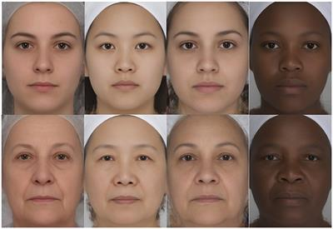
Facial Recognition and Racial Bias
🔹 Issue: Facial recognition models have been found to have higher error rates for people with darker skin tones compared to lighter-skinned individuals. 🔹 Example: A 2018 study by MIT Media Lab showed that commercial facial recognition systems from major tech companies had misclassification rates of up to 34% for darker-skinned women but less than 1% for lighter-skinned men. 🔹 Impact: This bias has led to wrongful arrests, misidentification, and racial profiling in law enforcement. 🔹 Solution: Improving diversity in training datasets, using debiasing techniques, and implementing human oversight in decision-making.

Slide 6
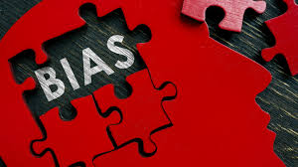
Gender Bias in Hiring Algorithms
🔹 Issue: AI-based hiring tools have exhibited gender discrimination, often favoring male candidates over female candidates. 🔹 Example: In 2018, Amazon’s hiring algorithm was found to downgrade resumes containing the word “women”(e.g., "women’s chess club") because it was trained on historical hiring data, which had male dominance. 🔹 Impact: Women were unfairly filtered out from job opportunities, reinforcing existing workplace inequality. 🔹 Solution: Using gender-neutral language, fairness constraints in model training, and regular audits of AI decisions.

Slide 7

Predictive Policing and Criminal Justice AI
🔹 Issue: Predictive policing AI, which aims to predict where crimes will occur or assess the likelihood of individuals committing crimes, has been shown to reinforce systemic racial biases. 🔹 Example: COMPAS (Correctional Offender Management Profiling for Alternative Sanctions), a criminal risk assessment tool, was found to incorrectly classify Black defendants as "high risk" at almost twice the rate of white defendants. 🔹 Impact: Unfair sentencing, over-policing of minority communities, and disproportionate imprisonment rates. 🔹 Solution: Implementing transparency in AI decision-making, removing racially biased historical data, and using fairness-aware models.

Slide 8

Discrimination in Credit Scoring and Lending AI
🔹 Issue: AI-driven credit scoring models have been found to discriminate against minority groups, leading to unfair denials of loans and higher interest rates. 🔹 Example: A 2019 study found that Black and Hispanic borrowers were charged higher interest rates for home loans compared to white borrowers with similar financial backgrounds. 🔹 Impact: Economic inequality, reduced financial opportunities for marginalized groups, and long-term wealth disparity. 🔹 Solution: Implementing fairness-aware machine learning models, using explainable AI (XAI) techniques to detect bias, and ensuring regulatory compliance.

Slide 9
Practical Approaches to Fair AI Development
To mitigate bias and build fair AI systems, organizations should adopt ethical and inclusive AI development strategies.
Ethical AI Principles in Model Design
Ensuring AI systems align with human values and promote fairness, transparency, and accountability.
Adopting frameworks like Fairness, Accountability, and Transparency in Machine Learning (FAT/ML) to guide ethical decision-making.
Regularly conducting AI audits to check for unintended biases.

Slide 10
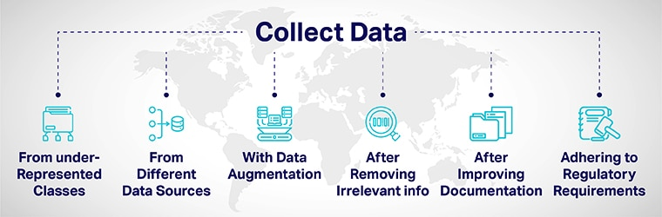
Inclusive Data Collection and Bias-Aware Algorithms
Ensuring datasets represent diverse populations to prevent bias.
Applying bias mitigation techniques at different stages of the ML pipeline:
Pre-processing: Rebalancing datasets to reduce bias before training.
In-processing: Modifying the learning algorithm to ensure fairness.
Post-processing: Adjusting model outputs to correct biases after training.

Slide 11

Human-in-the-Loop Approaches for Fairness Evaluation
Combining AI decision-making with human oversight to reduce errors and biases.
Involving domain experts, ethicists, and affected communities in AI evaluation and policy-making.
Using explainable AI (XAI) tools like SHAP and LIME to ensure transparency and accountability.

Slide 12
RECAP
1️⃣ AI Bias in Critical Areas – Bias in AI affects high-stakes domains such as facial recognition, hiring, criminal justice, and credit scoring, leading to unfair outcomes.
2️⃣ Facial Recognition Bias – AI models have higher error rates for darker-skinned individuals, resulting in misidentification and racial profiling in law enforcement.
3️⃣ Gender Bias in Hiring – AI-driven hiring tools have favored male candidates due to biased historical data, reinforcing workplace inequalities.
4️⃣ Predictive Policing Issues – AI models like COMPAS have wrongly classified Black defendants as high-risk, leading to racial discrimination in criminal justice.
5️⃣ Discrimination in Credit Scoring – AI-based loan approval systems have unfairly assigned higher interest rates to minority groups, widening economic disparities.
6️⃣ Ethical AI Development – Fair AI requires inclusive data collection, fairness-aware algorithms, and bias mitigation techniques at different stages of model development.
7️⃣ Human-in-the-Loop Approaches – AI systems should integrate human oversight, fairness evaluations, and explainability techniques like SHAP and LIME to enhance transparency.
8️⃣ Accountability & Regulation – Organizations must regularly audit AI models, ensure compliance with ethical standards, and adopt fairness frameworks for responsible AI deployment.

Slide 13

















الشراكات العالمية

Slide 14
شــــــكــــرًا لكــــــم
THANK YOU

